Slide 1
Chapter 3
Writing Functions in Assembly

Slide 2
Approach
Most of a program is written in a high-level language (HLL) such as C
easier to implement
easier to understand
easier to maintain
Only a few functions are written in assembly
to improve performance, or
because it’s difficult or impossible to do in a HLL.

Slide 3
Creating a Program
Most of code, including function main
Library header files
C sourcecode
Compiler
Object code
Linker
Execu-table Program
ASM sourcecode
Assembler
Object code
Librarycode
A few small functions

Slide 4
Consequence
Assembly functions must be compatible with:
How the C compiler invokes the execution of a function
How the C compiler passes parameters to functions
How the C compiler expects to receive results from functions
How the C compiler uses CPU registers

Slide 5
FUNCTION CALL AND RETURN Simple Call-Return in C
Suspend the current sequence
Record the return address
Transfer control to the function
Branch with Link Instruction (BL)
● ● ● f1() ; ● ● ● | void f1(void) { ● ● ● return ; }
Execute the function
Use the recorded return address to go back and resume the suspended code.
Branch Indirect Instruction (BX)

Slide 6
FUNCTION CALL AND RETURN ARM instructions used to call and return from functions
Instruction | Format |  | Operation
Branch with Link | BL | label | Function Call: LR ← return address, PC ← address of label
Branch Indirect | BX | LR | Function Return: PC ← LR
LR (aka R14) and PC (aka R15) are two of the 16 registers inside the CPU.
LR is the “Link Register” – used w/function calls to hold the return address
PC is the “Program Counter” – holds the address of the next instruction.

Slide 7
FUNCTION CALL AND RETURN Simple Call-Return in Assembly
The “Branch with Link” instruction (BL) saves the the address of the instruction immediately following it (the return address) in the Link Register (LR).
● ● ● BL f1 ● ● ● | f1: ● ● ● BX LR
Consider: There is only one Link Register. What if inside function f1 there is a call to another function?
The “Branch Indirect” instruction (BX) copies the return address from LR into PC, thus transferring control back to where the function had been called.

Slide 8

FUNCTION CALL AND RETURN Nested Call-Return in Assembly
Saves the contents of LR on the stack.
Saves the return address in LR
● ● ● BL f1 ● ● ● | f1: ● ● ● BL f2 ● ● ● BX LR | f2: ● ● ● BX LR
Modifies the link register (LR), writing over f1’s return address!
PUSH {LR}
POP {LR}
Copies the saved return address from LR back into PC
Restores the contents of LR from the stack.

Slide 9
FUNCTION CALL AND RETURN ARM instructions used in functions that call other functions
SP is one of the 16 CPU registers (R13) – holds the address of the top of the stack.
1000 | Pushed data
996 | Pushed data
992 | Top of stack
988
984
980
976
972
(register R13)
SP | 992
Unused Stack
Space
Instruction | Format |  | Operation
Push registers onto stack | PUSH | register list | SP ← SP – 4 × #registers Copy registers to mem[SP]
Pop registers from stack | POP | register list | Copy mem[SP] to registers, SP ← SP + 4 × #registers
(memory)
“register list” format: { reg, reg, reg-reg, …}

Slide 10
Optimizing Function Calls
f1: PUSH {LR}
●
●
●
BL f2
●
●
●
POP {LR}
BX LR
f1: PUSH {LR}
●
●
●
BL f2
●
●
●
POP {PC}

Slide 11
Optimizing Function Calls
● ● ● BL f1 ● ● ● | f1: ● ● ● BL f2 BX LR | f2: ● ● ● BX LR
PUSH {LR}
POP {LR}
● ● ● BL f1 ● ● ● | f1: ● ● ● B f2 | f2: ● ● ● BX LR

Slide 12
ARM PROCEDURE CALL STANDARD Registers used as input parameters
Register | AAPCS Name | Usage
R0 | A1 | 1st parameter
R1 | A2 | 2nd parameter
R2 | A3 | 3rd parameter
R3 | A4 | 4th parameter
One register is used for each 8, 16 or 32-bit parameter.
A sequential register pair is used for each 64-bit parameter.

Slide 13
ACCESSING PARAMETERS INSIDE THE FUNCTION How parameters are passed to a function by the compiler
C Function Call | Compiler Output
int8_t x8 ;
int32_t y32 ;
int64_t z64 ;
●
●
foo(x8, y32, z64) ;
●
●
foo(5, -10, 20) ;
●
●
LDRSB R0,x8 // R0 <-- x8
LDR R1,y32 // R1 <-- y32
LDRD R2,R3,z64 // R3.R2 <-- z64
BL foo
●
●
●
MOV R0,5 // R0 <-- 5
MOV R1,-10 // R1 <-- -10
MOV R2,20 // R3.R2 <-- 20
MOV R3,0
BL foo
Inside foo, you must use the register copies of the actual arguments.

Slide 14
ARM PROCEDURE CALL STANDARD Registers used to return function result
Register | AAPCS Name | Usage
R0 | A1 | 8, 16 or 32-bit result, or the least-significant half of a 64-bit result
R1 | A2 | The most-significant half of a 64-bit result

Slide 15
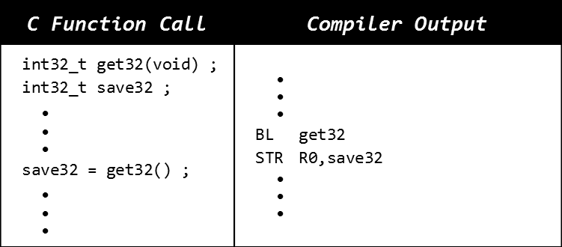
PREPARING THE RETURN VALUE Functions that return an 8, 16 or 32-bit result
Functions must provide a full 32-bit representation of return value, even for 8 and 16-bit results.

Slide 16
Review Summary
Call functions using Branch with Link (BL)
Saves the return address in Link Register (LR)
Copies the target address into Program Counter (PC)
Return from a function using BX LR
Writing functions that call other functions:
Using BL to call another function changes LR
Use PUSH {LR} / POP {LR} to preserve LR
Pass parameters using registers R0-R3
64-bit parameters in consecutive register pair
Return 8, 16 and 32 bit results using R0
64-bit result returned in R1.R0 register pair

Slide 17
Review Summary
f2(int32_t, int32_t) ;
void f2(void) ;
void f1(void)
{
.
.
.
.
.
}
PUSH {LR}
f1: .
.
.
.
.
.
.
int32_t f1(void)
MOV R0,1
MOV R1,2
BL f2
f2() ;
f2(1, 2) ;
return 10 ;
MOV R0,10
BX LR
POP {PC}

Slide 18
PREPARING THE RETURN VALUE Promoting a return value from 8 to 16 or 32 bits
C Function Call | Compiler Output
uint8_t save8, get8(void) ; uint16_t save16 ; uint32_t save32 ; uint64_t save64 ; ● ● ● save8 = get8() ; save16 = (uint16_t) get8() ; save32 = (uint32_t) get8() ; ● save64 = (uint64_t) get8() ; ● ● ● | ● ● ● BL get8 STRB R0,save8 BL get8 STRH R0,save16 BL get8 STR R0,save32 ● BL get8 MOV R1,0 STRD R0,R1,save64 ● ● ●
8, 16 and 32-bit func-tions must always provide a 32-bit result.
Promotion to 64-bits requires extending the result after the call

Slide 19
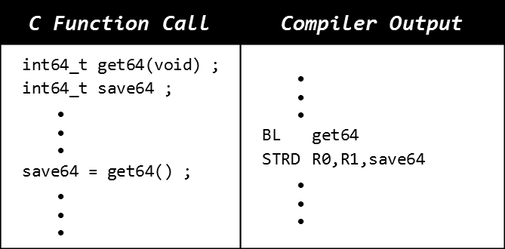
PREPARING THE RETURN VALUE Functions that return 64-bit result
Functions that return a 64-bit result leave it in R0 and R1 before returning.

Slide 20
REGISTER USAGE CONVENTIONS ARM PROCEDURE CALL STANDARD
Register | AAPCS Name | Usage | Notes
R0 | A1 | Argument / result /scratch register 1
R1 | A2 | Argument / result /scratch register 2
R2 | A3 | Argument / scratch register 3
R3 | A4 | Argument / scratch register 4
R4 | V1 | Variable register 1 | Must preserve original contents
R5 | V2 | Variable register 2
R6 | V3 | Variable register 3
R7 | V4 | Variable register 4
R8 | V5 | Variable register 5
R9 | V6 | Variable register 6
R10 | V7 | Variable register 7
R11 | V8 | Variable register 8
R12 | IP | Intra-Procedure-call scratch register
R13 | SP | Stack Pointer | Reserved, Do not use
R14 | LR | Link Register
R15 | PC | Program Counter

Slide 21
FUNCTION CODING CONVENTIONS Functions that modify only registers R0 - R3, R12
Using only R0-R3, R12 and no function call |  | Using only R0-R3, R12 and calling another function
f1: ● ● ● OK to modify ● R0-R3 and R12 ● BX LR |  | f2: PUSH {LR} ● ● OK to modify R0–R3, R12 ● BL f3 ● ● OK to modify R0–R3, R12 ● POP {PC}
Function f3 might modify R0 – R3, R12

Slide 22
FUNCTION CODING CONVENTIONS Functions that modify for example registers R4 and R5
Using R4 and R5 and no function call |  | Using R4 and R5 and calling another function
f1: PUSH {R4,R5} ● ● OK to modify ● R0-R5 and R12 ● POP {R4,R5} BX LR |  | f2: PUSH {R4,R5,LR} ● ● OK to modify ● R0–R5 and R12 ● BL f3 ● ● OK to modify ● R0–R5 and R12 ● POP {R4,R5,PC}
Function f3 might modify R0-R3 and R12, but preserves R4-R11

Slide 23
FUNCTION CODING CONVENTIONS Two functions with parameters, one calling the other
C Version | Assembly Version
int32_t f1(int32_t x) { return f2(4) + x ; } | f1: PUSH {R4,LR} // Preserve R4 MOV R4,R0 // Keep x safe in R4 MOV R0,4 // R0 <-- f2’s arg BL f2 // R0 <-- f2(4) ADD R0,R0,R4 // R0 <-- f2(4) + x POP {R4,PC} // Restore R4
On entry to function:
R0
parameter x
R4
some value
After 1st MOV instruction:
R0
parameter x
R4
parameter x
After 2nd MOV instruction:
R0
constant 4
R4
parameter x
After the BL instruction:
R0
f2 return value
R4
parameter x
After the ADD instruction:
R0
f1 return value
R4
parameter x
After the POP instruction:
R0
f1 return value
R4
some value

Slide 24
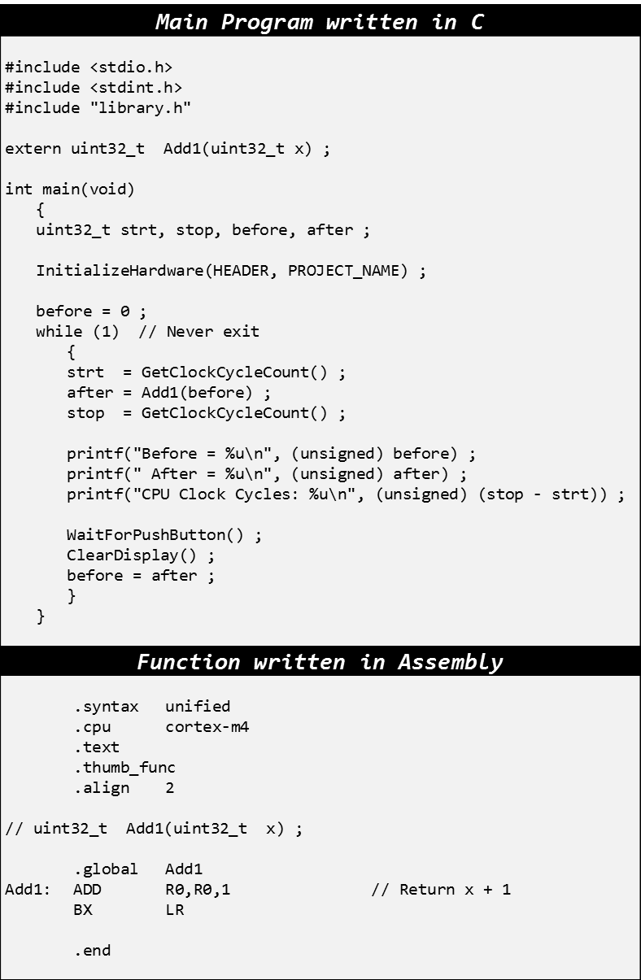

Lab 1, Part 1: Sample Program
RUN DEMO

Slide 25
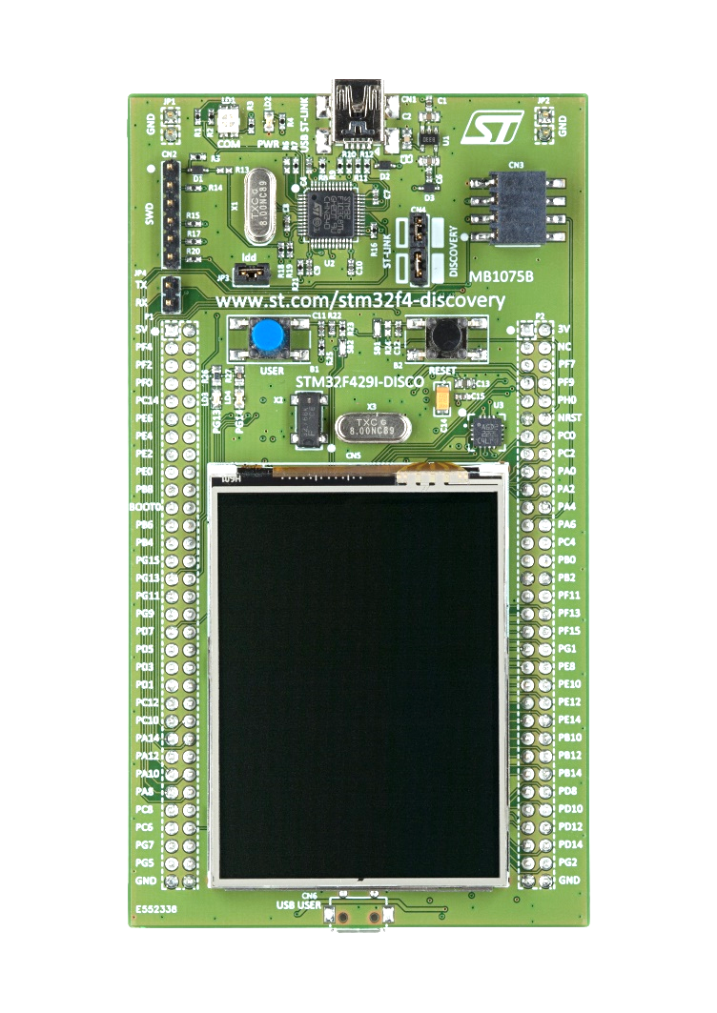
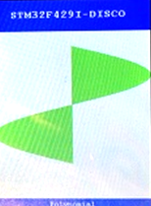
void InitializeHardware(char *, char *) ;
Must be first executable statement
Initializes processor, CPU clock cycle counter, the display and user push button.
Creates stack and heap and initializes static variables.
Formats display area

Slide 26
uint32_t GetClockCycleCount(void) ;
start = GetClockCycleCount() ;
// do some calculation here
stop = GetClockCycleCount() ;
printf("Cycles=%d\n", stop-start) ;
Returns the number of processor clock cycles since initialization.
STM32F429I-DISCO
Cycles=1788
GetClockCycles

Slide 27
void WaitForPushButton(void) ;
Causes program to pause and wait for user to push the blue push button on the board.

Slide 28
void ClearDisplay(void) ;
STM32F429I-DISCO
Sine Function
Erases the scrollable area of the display.

Slide 29
Lab 1 (Part 2): Decimal/Binary Conversions
void Dec2Bin(float x, int bin[8])
{
// To be implemented by student
// Input Parameter: 0.0 < X < 1.0
// Output Parameter: bin[0] = Least significant bit
// bin[7] = Most significant bit
// Return value: None
}
float Bin2Dec(int bin[8])
{
// To be implemented by student
// Input Parameter: bin[0] = Least significant bit
// bin[7] = Most significant bit
// Return value: 0.0 < float < 1.0
}

Slide 30
Bin2Dec (The "easier" one)
Use a modified Polynomial Evaluation:
Assume the 8 bits represent an integer.
E.g., 10010011₂ = 147₁₀
Convert the integer to fraction:
Note: 0.10010011 = 10010011/2⁸
E.g., 147/256 = 0.57421875₁₀

Slide 31
Dec2Bin (A little more difficult)
Binary Rounding:
Result must be limited to 8 bits.
If 9th bit = 1, add 1 to the 8-bit result.
Easier if scaled first:
0.0 ≤ x < 1.0 → 0.0 ≤ 2⁸x < 256.0
Extract integer and fractional parts of x:
Add 1 to integer if fractional part ≥ 0.5
Convert integer to binary (as your output)

